Slide 1



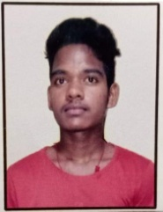
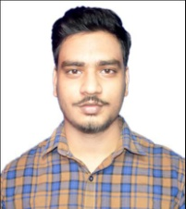






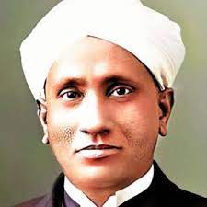
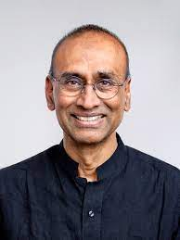
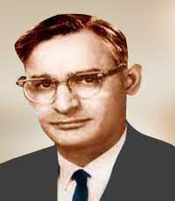
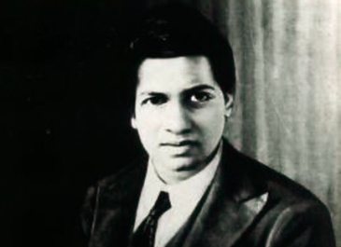


READERS INSTITUTE
(An initiative by a group of eminent authors and educators)
( IIT-JEE & NEET )
JOIN NOW
Reassures Your Confidence
With a Holistic Approach in Education
Salutes
Indian Scientists
Prof. C. V. Raman (Physics)- (Nobel laureate)
Prof. V. Ramakrishnan (Chemistry)- (Nobel laureate)
Prof. Dr. H. G. Khurana (Biology)- (Nobel laureate)
Prof. Srinivasa Ramanujam (Greatest Mathematican)
www.readersinstitute.com

Slide 2


An appeal to the parents
New education policy commands a uniform standard of education in all states. But, unfortunately, there is a severe mismatch in this aspect as compared to some states like Andhra Pradesh, Telangana, Kota etc. Based upon the vast experience and expertise of our team members all over the country, we proclaim that the result of Odisha in JEE and NEET are devastating. Who is responsible for this? Can we blame the teachers, students, parents, government or some others? It is a matter of introspection. It is our prime motive to enhance the results of NEET and JEE to re-establish the past glory of Odisha.
Our journey for imparting education in Odisha started in 2020.We used to work with the eminent institutes in the field of JEE and NEET education outside Odisha. By the request of some institute at Balasore we associated with them. Advertising our name and fame and our online classes they managed to gather hundreds of students. After getting the strength they tried to manage the classes with many foul means. This manipulation was totally unacceptable for us and we decided to distance from them. Eventually, after Covid-19, in 2022, we established Readers Institute and produced 25% result in JEE, NEET and others in the first session (2022-23). A group of academicians, educators and authors are associated with the institute in hybrid mode.
Now, let us try to answer the afore-mentioned questions regarding the failure of the result in Odisha. The first step for the parents is to select the institute by verifying whether the institute is run by an academician or not. An academician knows how to probe the standard of students and adopt a holistic approach for educating them. Furthermore, he understands the worth of a teacher. But, in general, the impertinent behavior of the non-academicians towards the students and teachers is unacceptable. Their manipulation of the results of students to satisfy the parents is notorious and disgraceful. The illicit practice of inviting the educators and exploiting them after attaining the pseudo-success must be condemned. The parents should realize these facts. Therefore, an association of the parents and academicians is highly desirable for improving the results of JEE, NEET , OUAT and others in Odisha.
+91-93376 48807
info@readersinstitute.com

Slide 3
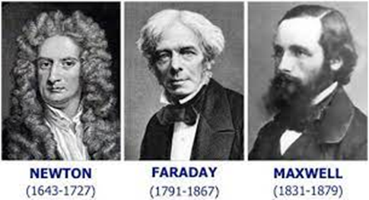
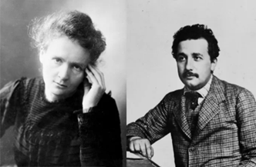
CONVICTION
All branches of science such as Physics, Chemistry, Mathematics and Biology (Botany and Zoology) are interrelated, interconnected and interdependent. So, each subject should be dealt with equal importance without thinking them as absolutely separate branches, which can be explained as following history of science:
Newton invented calculus (mathematics) to explain physics (laws of motion). Michael Faraday founded Electromagnetic Induction (Physics) and Electrolysis (Chemistry). Clerk Maxwell explained Faraday’s work on Electromagnetism by his electromagnetic wave equations which is a mathematical work. Einstein followed Maxwell’s classical physics and related it to quantum physics by Planck’s mathematical formula of quantization of energy. Quantum physicist Schrodinger established a link between life (biology) and physics. Madam Curie received one Nobel Prize in physics and another in chemistry. So, all branches of science are interrelated. All concepts of science (phenomena) are explained by mathematical equations. Scientists are continuously trying to explain all realities of nature in a grand mathematical framework called theory of Everything (TOE) which is one ultimate motto of science. The other motto of science is to solve the problems of human being and the other living entities.

Slide 4
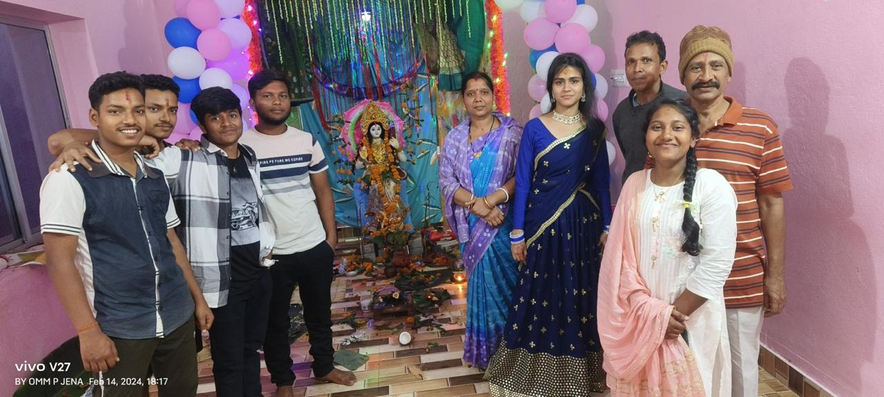
Motto
A person’s growth is hindered without pure mind and a clean body-(Sam Veda)
So, we adopt a stress free environment with a holistic and personalized approach.
Access to the Vedas is the greatest privilege this century may claim over all previous century- J. Robert Oppenheimer
We whole-heartedly celebrate each Vedic ritual (Ganesh and Saraswati Puja etc) to practice Sanatana Dharma to realise its scientific influence on body-mind system.
Truth is one. Sages call it by various names- (Rig Veda)
A complete knowledge explains all realities in one frame. Knowledge is supreme. Knowledge alone can solve all problems and let others to live in harmony.
Student-friendly atmosphere is essential for an easy flow of knowledge from teachers to students.
Mission
To enhance the IIT-JEE ,NEET & OUAT results by adopting AI-Powered
Active Teaching and Active Learning (ATAL) for sure success of the IIT-JEE and NEET aspirants
Specialist doctors are now
Just a phone call away!
+1-9985 49817

Slide 5
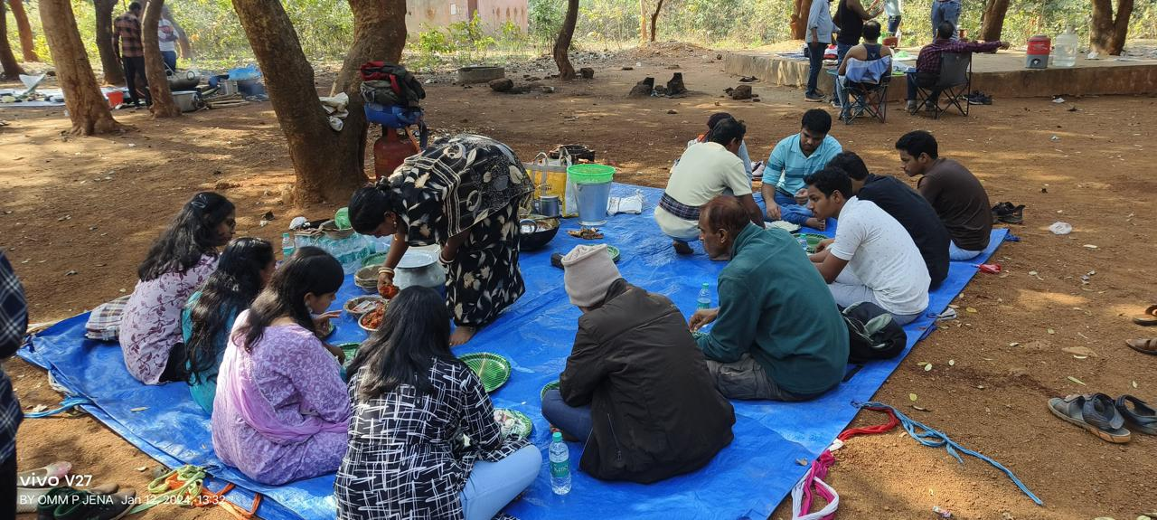
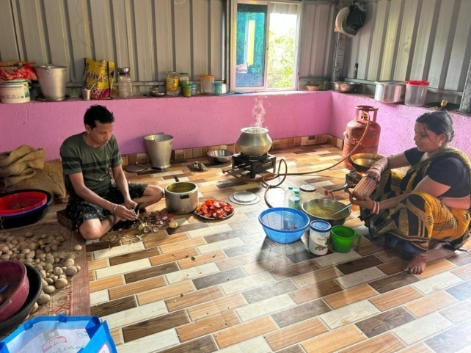
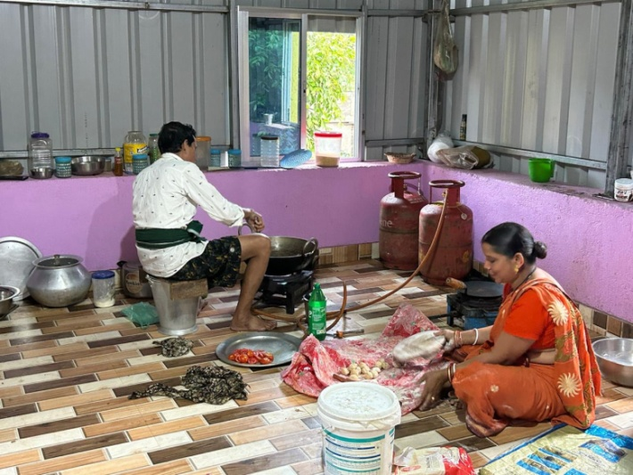
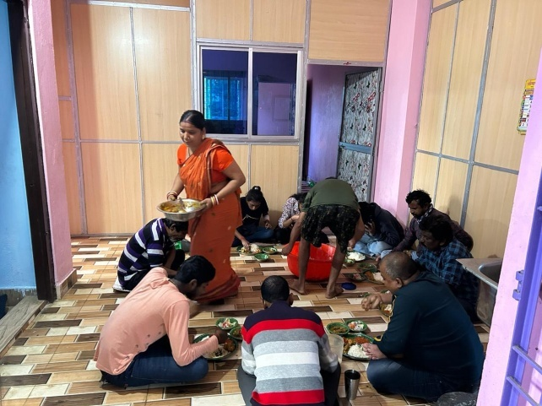
Catering
We have an expert home-cooked and student-run catering system. It prepares palatable lunch and dinner according to the students’ choice. The menu is flexible and students can change it at any time. There is no compromise with the quality and quantity of food.
Programme
+2 Integrated Science
IIT-JEE,NEET & OUAT (One year)
Customized programme according to need of a student
+9855 49817

Slide 6

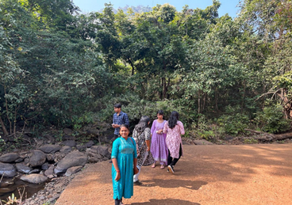
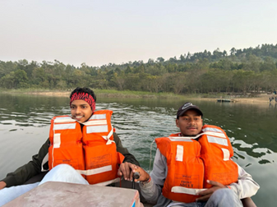
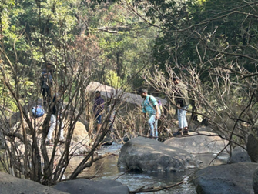
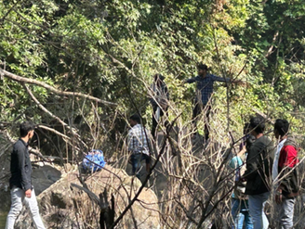
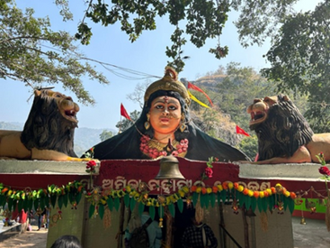
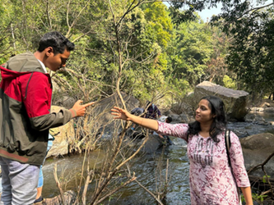
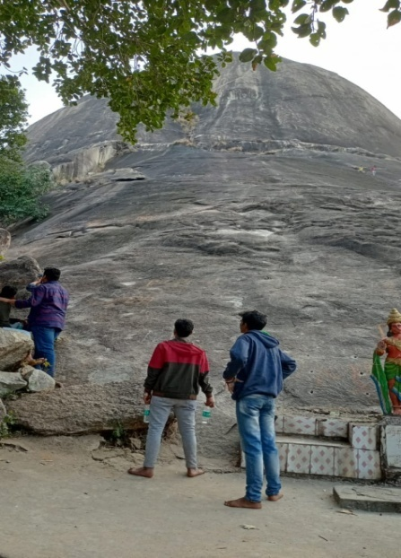
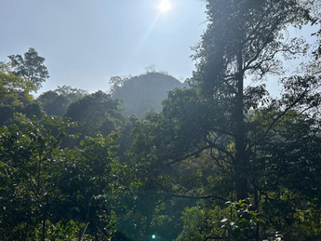


Recreation
We believe in full enjoyment in the lap of nature for the peace of mind. So we took advantage of the group outings such as picnic to the natural forests, mountains, water reservoirs and waterfalls. Our students had chosen to visit world famous Simplipal Reserve Forest.
The combination of picnic, trekking, bathing, swimming, boating and mountaineering is itself all-in–one package for a life time experience. The natural ambience, crystal clear mineral water and enjoying the presence of rare species of birds and animals is a matter of great pleasure. The combination of the clear sky, dustless atmosphere and a sunny day in the mid-December is mostly enjoyable. May the Divine Mother Ambika Devi who is the presiding deity of the Dev-Kund bless us with her choicest blessings. After paying homage to the Goddess, we returned to our lunch break prepared by Readers Catering at the base of the hills. After relishing the picnic lunch we enjoyed the boating in the reservoir of Kala Dam in the confluence of three rivers near Similipal forest - a thing of beauty is a joy forever.
Our teachers are not only strict as parents, but also very friendly with the students. Rock climbing in Bhimsila (a huge solitaire stone) is a thrilling experience. In Dwapara yuga, Pandavas stayed here for some time.
  info@readersinstitute.com
  readersinstitute.com

Slide 7

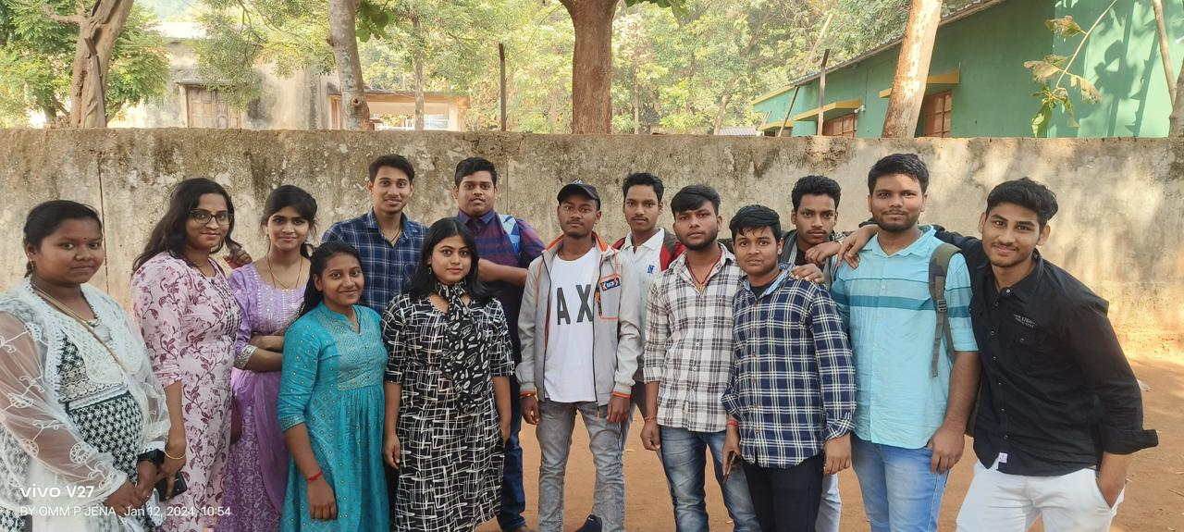
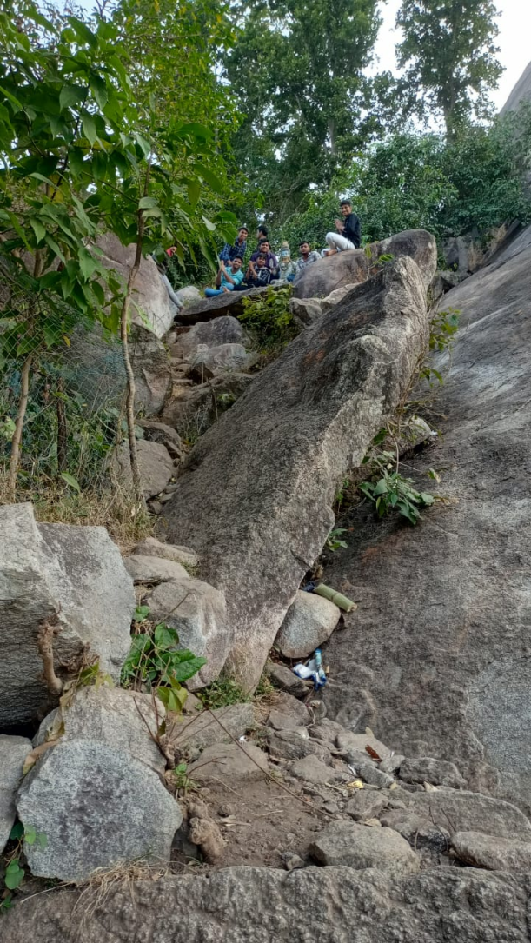
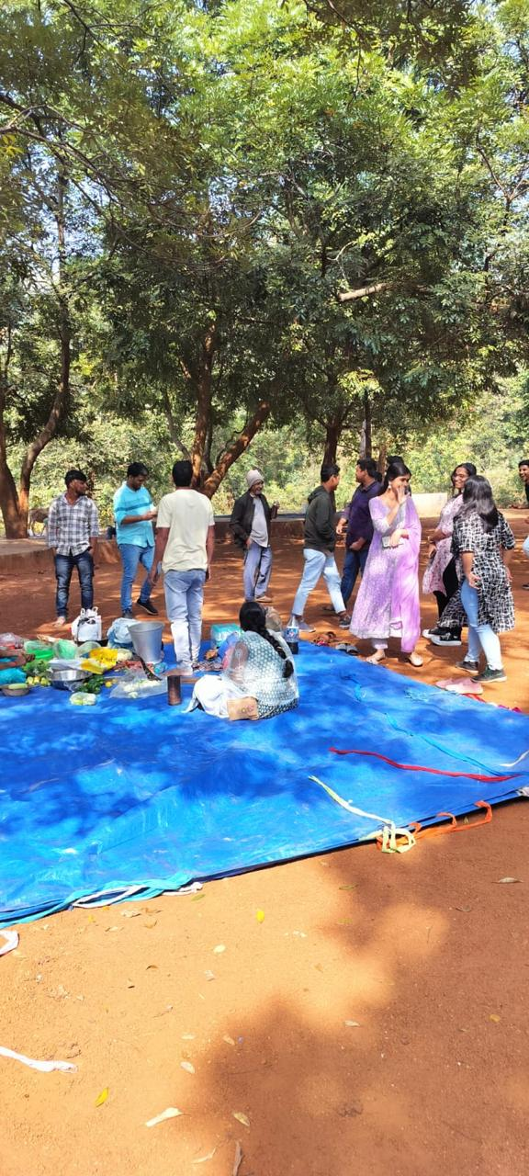
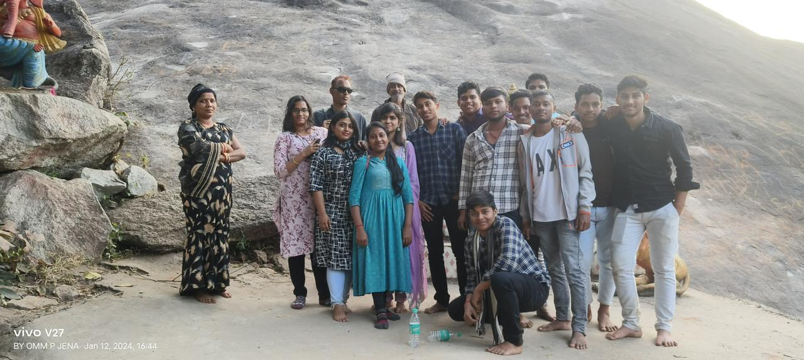
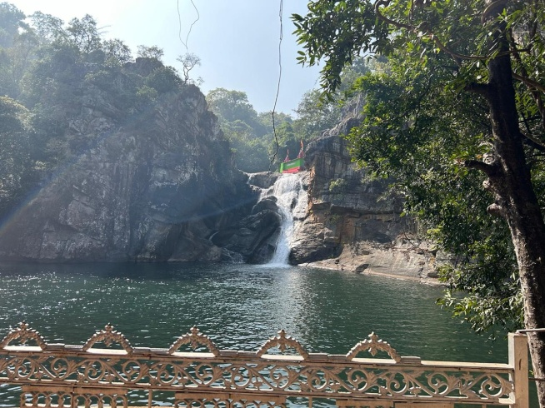

Slide 8


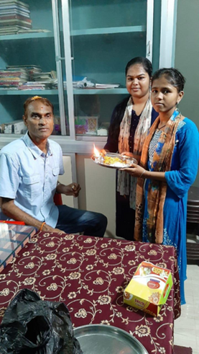
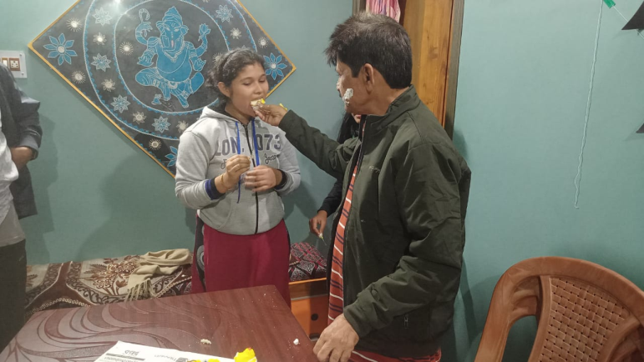
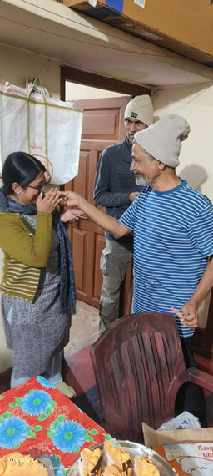
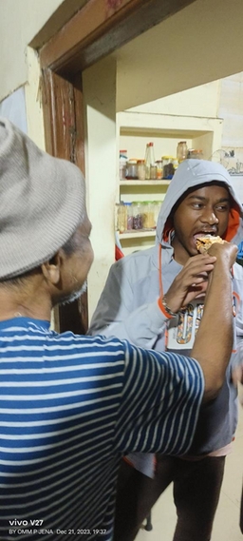
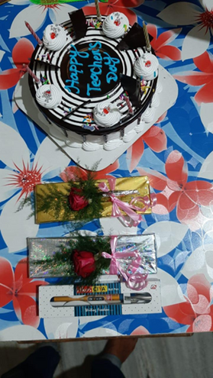
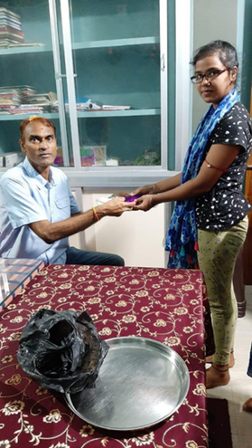
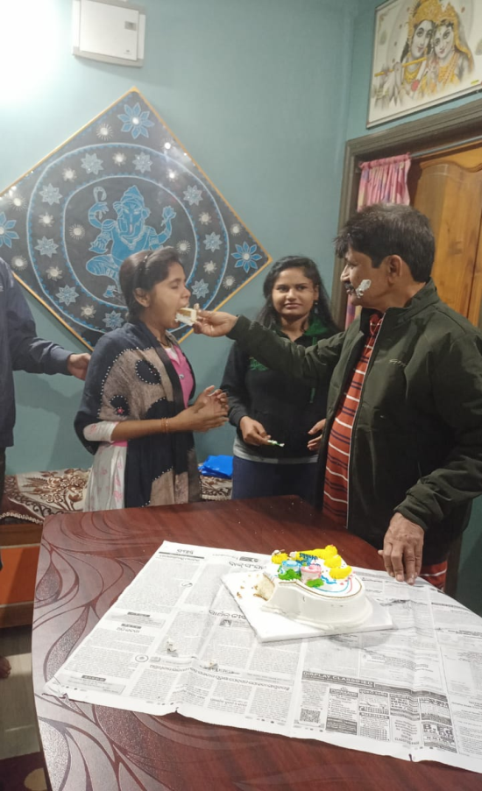
Celebrations
There are varieties of celebrations. Observing the birthday of gurus is considered to be a means of direct exchange of love and respect. The 2nd type of celebration is the appearance (birth) day of Gods and Goddess (Ganesh, Saraswati puja, Hanuman Jayanti etc).The 3rd type of celebration is for Independence Day, Republic Day, Women’s Day, Teachers Day, Children’s Day, Yoga Day etc).The common goal of all celebrations is to enhance our intellectual and spiritual power. Teacher’s day and Children’s Day are the occasions for glorifying the loving teacher-student relationship.
  info@readersinstitute.com
  readersinstitute.com

Slide 9
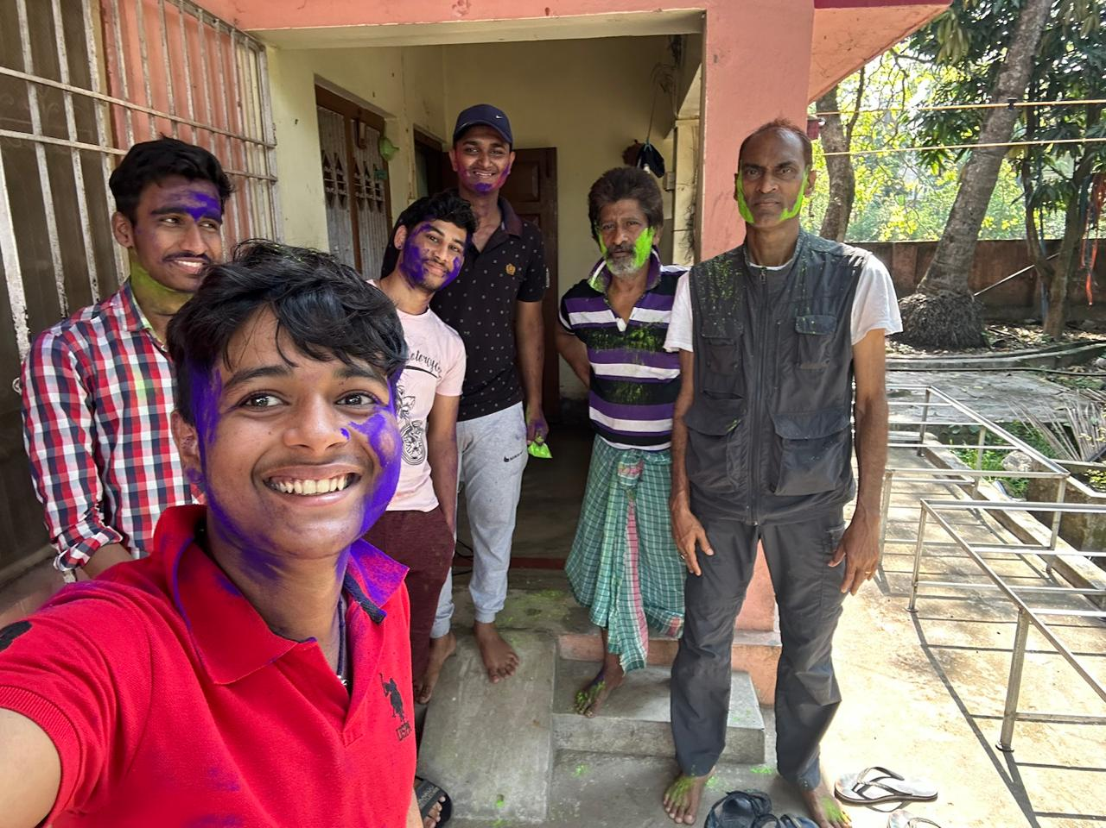

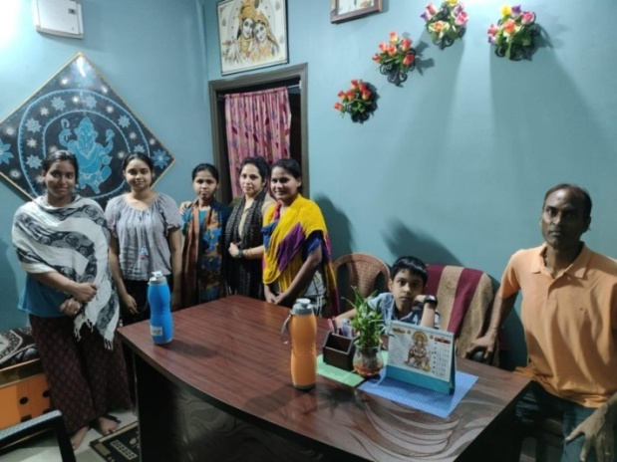
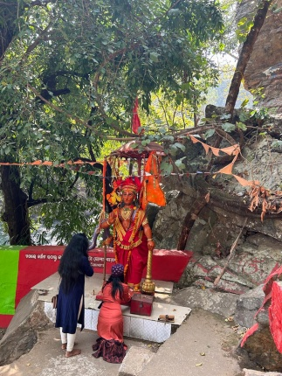
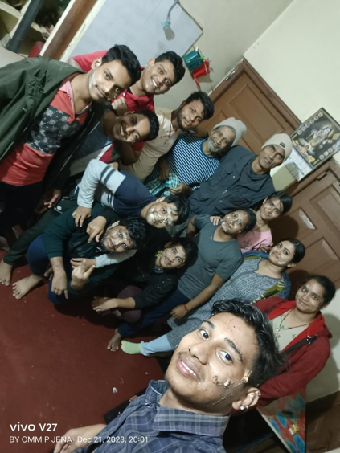
Student Galleries

Slide 10
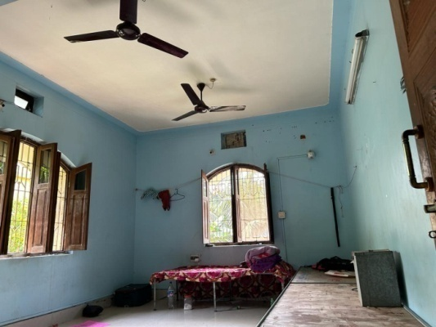
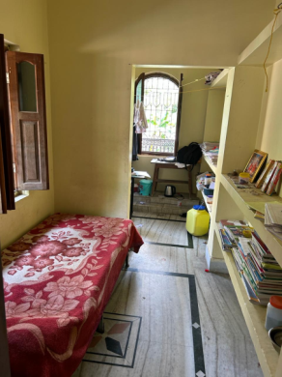


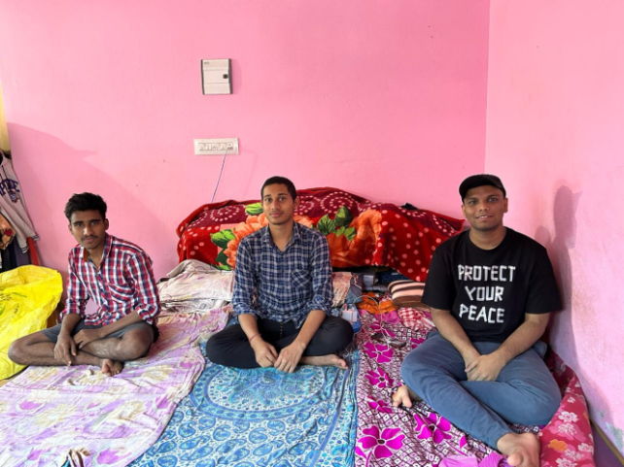

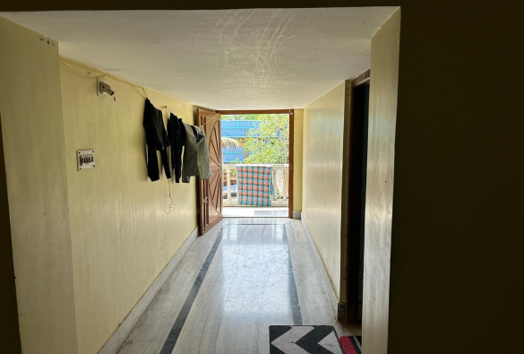

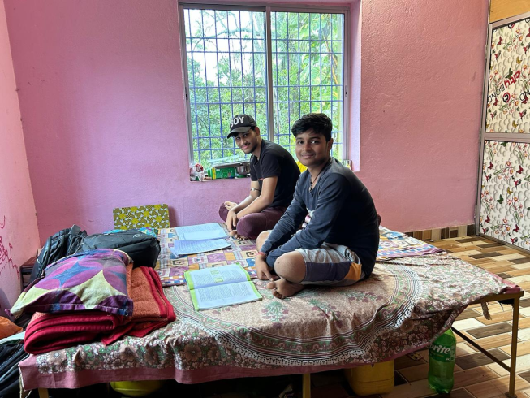
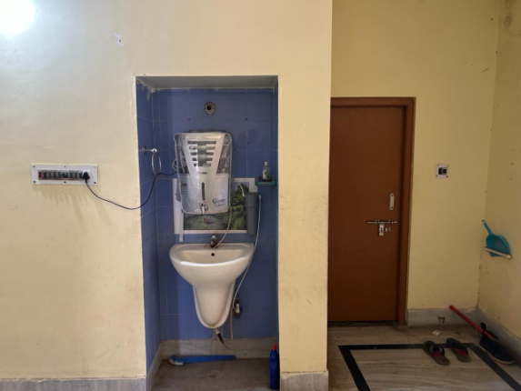
Accommodation, Office and Information Centre
We have well ventilated, semi-furnished hygienic accommodation in the vicinity of the institute and FM College. We provide RO, copper and alkaline mineral water purifiers in our office and accommodation. We have guest house for staying of the visiting experts and parents. The students can chose to stay in single, double and triple bedded rooms. Our information centre (main office),guest house and hostels are situated near Shanti Kannan. We have single, double, triple and group accommodation.
)
Notes:
aaaaa

Slide 11
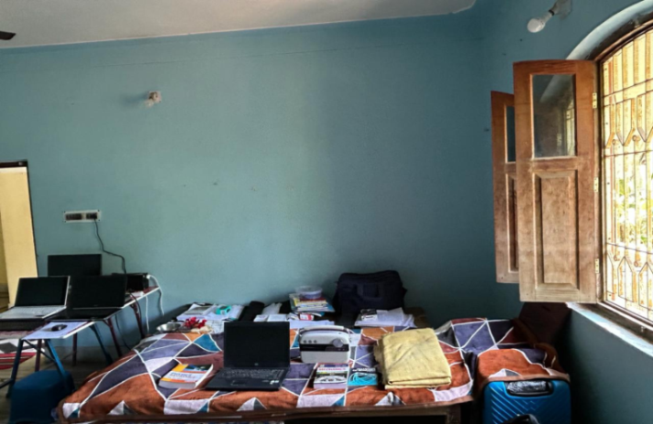
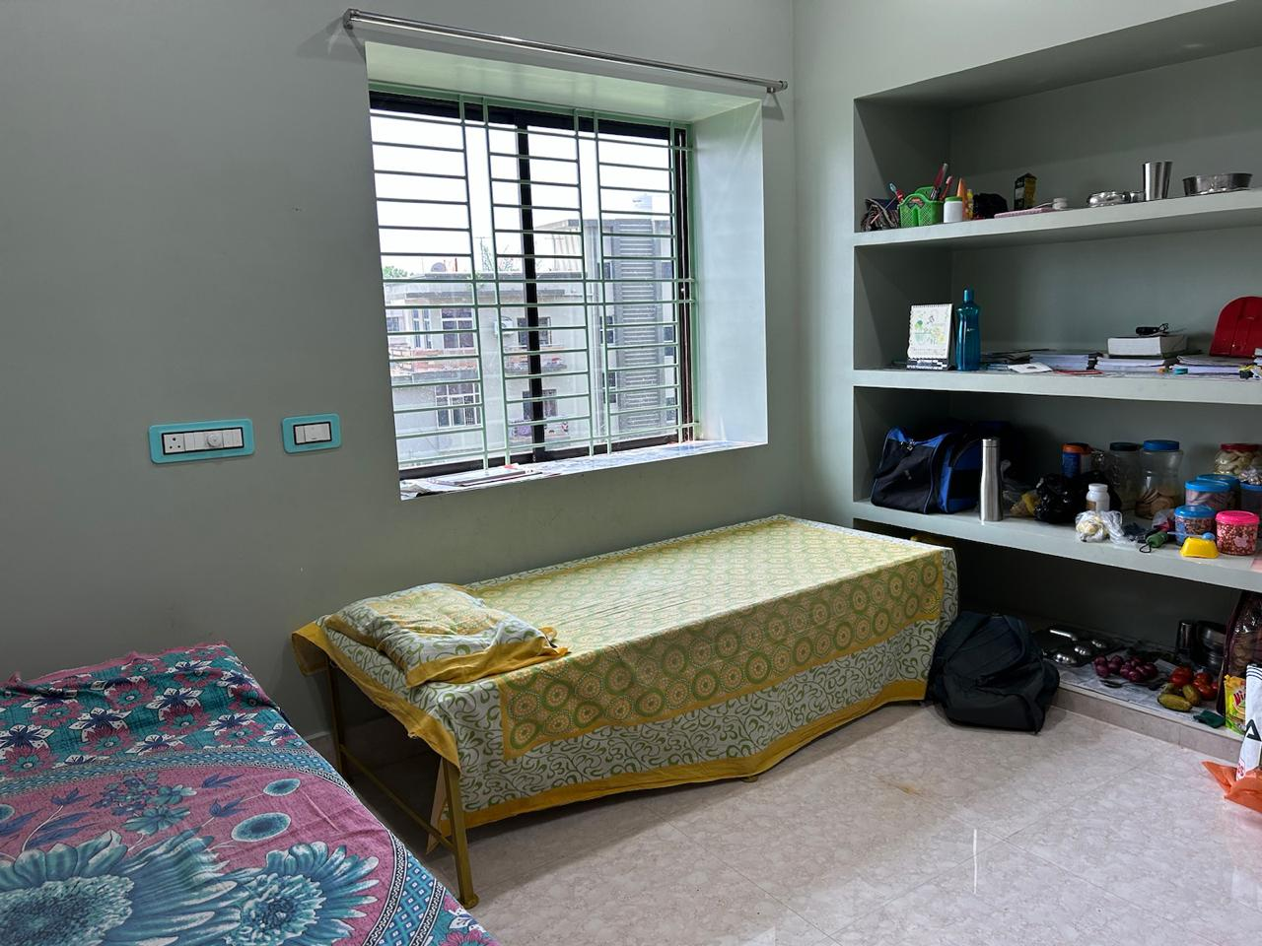

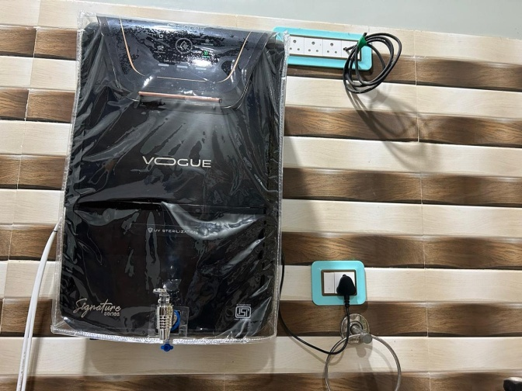


Slide 12
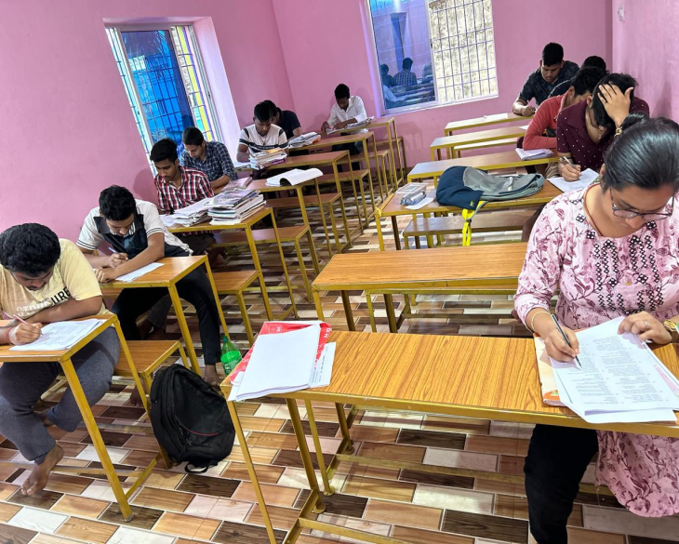
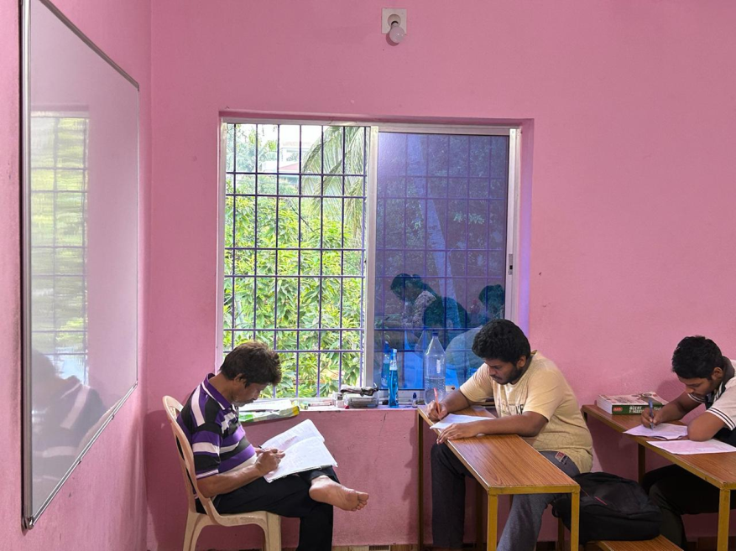
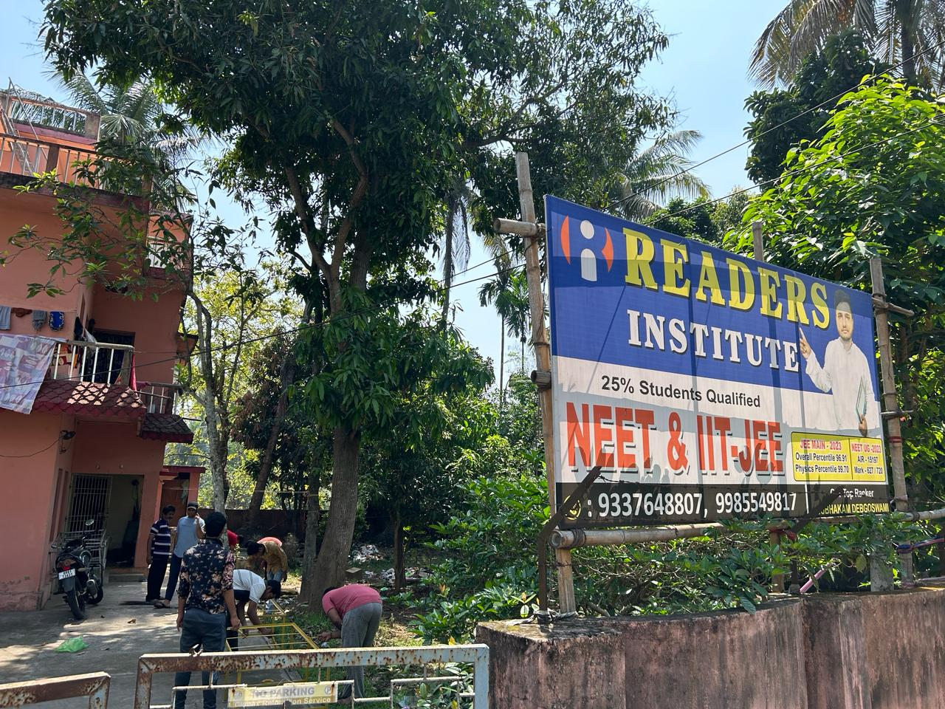
Class Rooms, Teaching and Tests
We have well-ventilated class rooms with proper sunlight with best quality white boards and multi-colour markers. We have a noise-free campus so that a teacher can deliver his teachings and a student can easily concentrate on his study without any dust and noise pollution. We have weekly-tests, part-tests and grand-tests with scholarly set question papers.
In super-30 class
TEACHER STUDENT RATIO = 1;3
Library and Information Centre
The students can access a good collection of books in our library which is located at our information centre very close to Shanti Kannan.

